Slide 1

Retinal image analysis for diabetic retinopathy under: Dr. Parul madan associate professor by: Manas Srivastava roll no: 08 section: DS-2

Slide 2
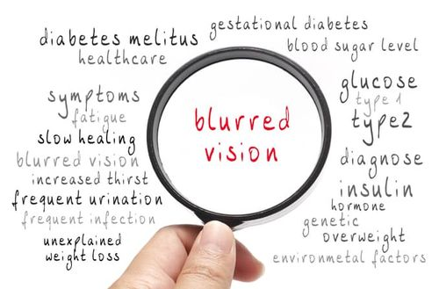
Introduction
Diabetic retinopathy is a progressive eye disease caused by damage to the blood vessels in the retina, often because of long-term diabetes. It is one of the leading causes of preventable blindness worldwide, affecting millions of people with diabetes.
The condition develops when high blood sugar levels weaken the blood vessels in the retina, causing them to leak, swell, or grow abnormally.
Early detection through regular eye screenings is essential for effective management, which may include lifestyle changes, medications, or surgical interventions.
With the increasing prevalence of diabetes globally, early and accurate detection using advanced technologies like AI-driven diagnostic tools has become a vital aspect of modern healthcare.

Slide 3
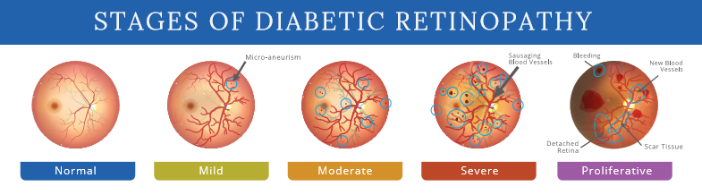
Problem statement
Developing an automated system that can analyse retinal images, classify the severity of the disease, and assist healthcare professionals in providing timely and effective treatment.
The problem is to perform image classification. Given a fundus photograph, the task is to predict the class to which the image belongs. The classes to predict are: 0 - Normal 1 - Mild 2 - Moderate 3 - Severe 4 - Proliferative

Slide 4
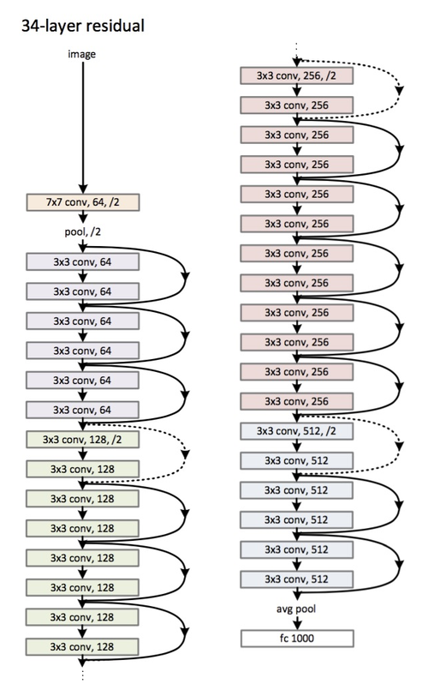
Methodology
Data Preparation
Fundus images are collected and labeled based on their respective severity levels.
Images are preprocessed by resizing them to match the input size of the model (e.g., 224x224 for ResNet).
Data augmentation techniques (e.g., rotation, flipping, and cropping) are applied to increase data diversity.
Images are normalized to improve model performance.
Model Design and Transfer Learning
Transfer learning is employed due to the limited availability of labeled data.
A pre-trained ResNet34 model, trained on the ImageNet dataset, is used as the base.
The fully connected (FC) layer of ResNet34 is replaced with a custom classifier to match the 5 output classes for diabetic retinopathy classification.

Slide 5
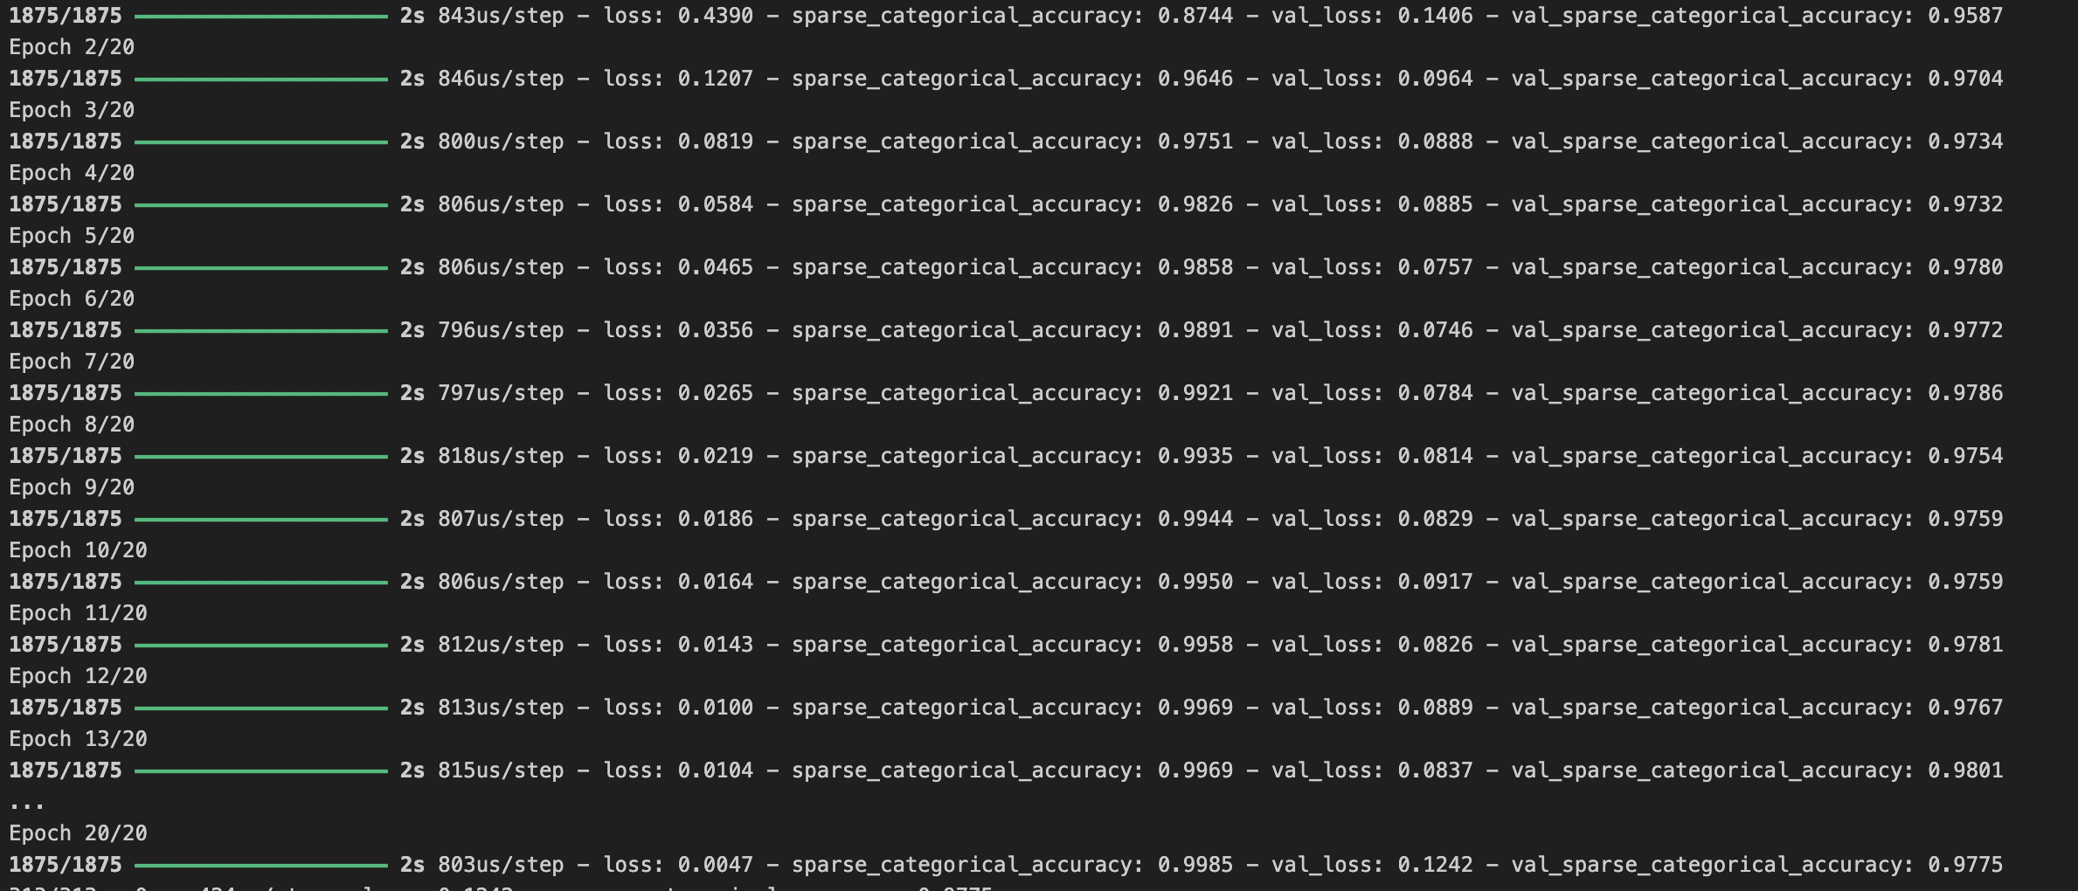
Methodology
Model Compilation and Training
The model is compiled with an appropriate optimizer (e.g., Adam), loss function (e.g., cross-entropy loss), and evaluation metrics (e.g., accuracy).
The training dataset is used to fine-tune the pre-trained model on the task-specific DR data.
A validation dataset is used to monitor model performance during training and prevent overfitting.
Evaluation and Testing
The trained model is evaluated using metrics such as accuracy, precision, recall, and F1-score on a test dataset to measure classification performance.
Predictions are made on new images to verify the model's robustness.

Slide 6
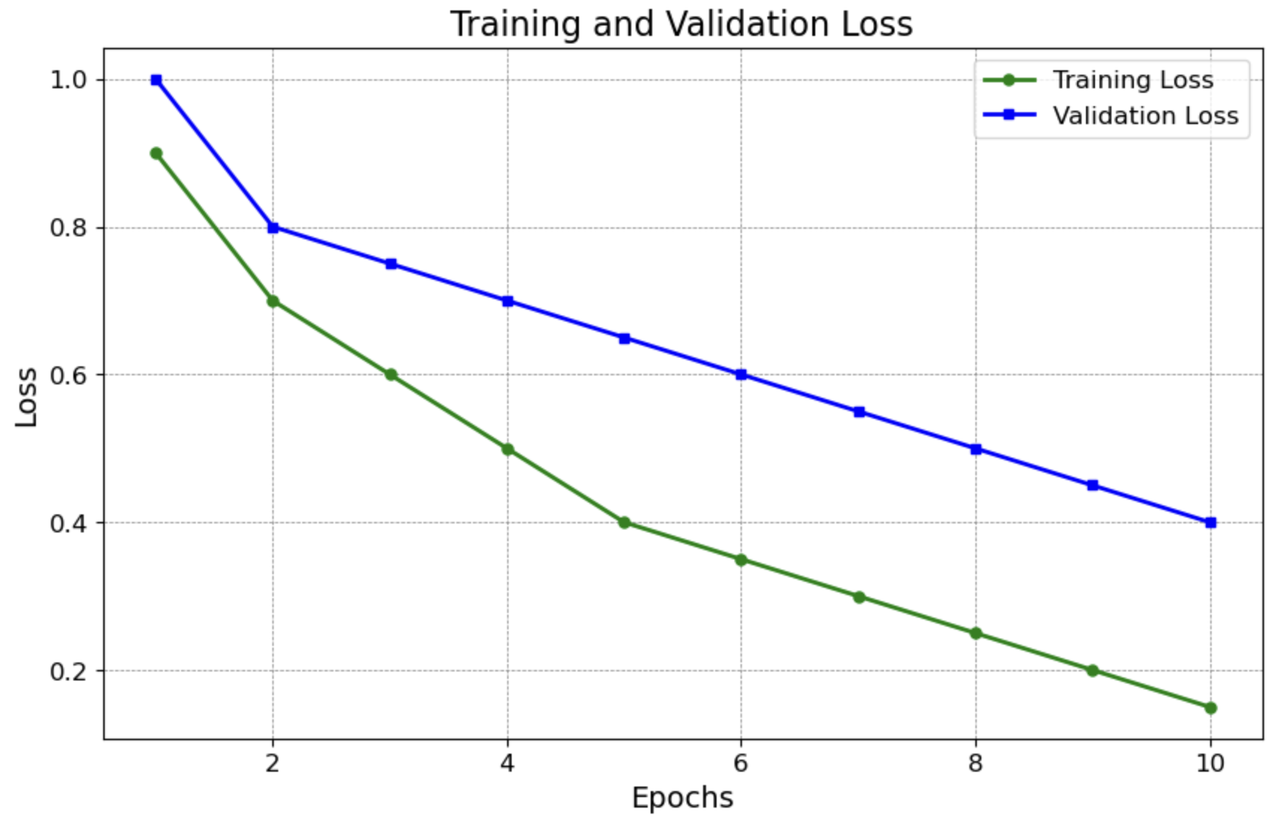
Methodology
Plotting the graphs:
The training and validation loss graph is a crucial tool for understanding the model's learning behaviour. It illustrates the loss values for both the training and validation datasets across epochs.
Deployment
The final model is saved and can be deployed in a clinical setting or integrated into applications for automated DR detection.
Further enhancements include using larger datasets, advanced architectures, or assembling multiple models for improved accuracy.

Slide 7
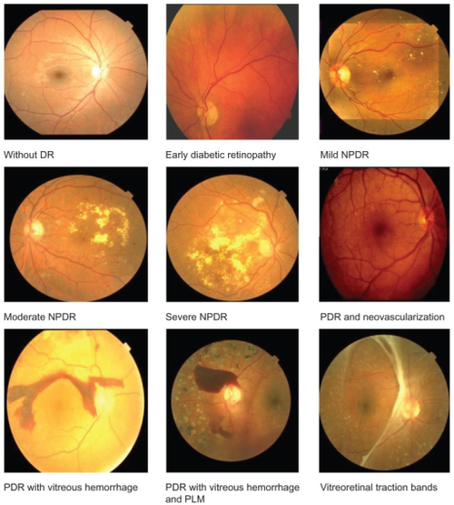
Results
Model Results
The model was trained for 20 epochs and evaluated on a test dataset. The key metrics obtained are as follows:
Training Loss and Accuracy:
Final Training Loss: 0.0047
Final Training Accuracy: 99.85%
Validation Loss and Accuracy:
Final Validation Loss: 0.1242
Final Validation Accuracy: 97.75%
Test Set Performance:
Test Loss: 0.1242
Test Accuracy: 97.75%

Slide 8
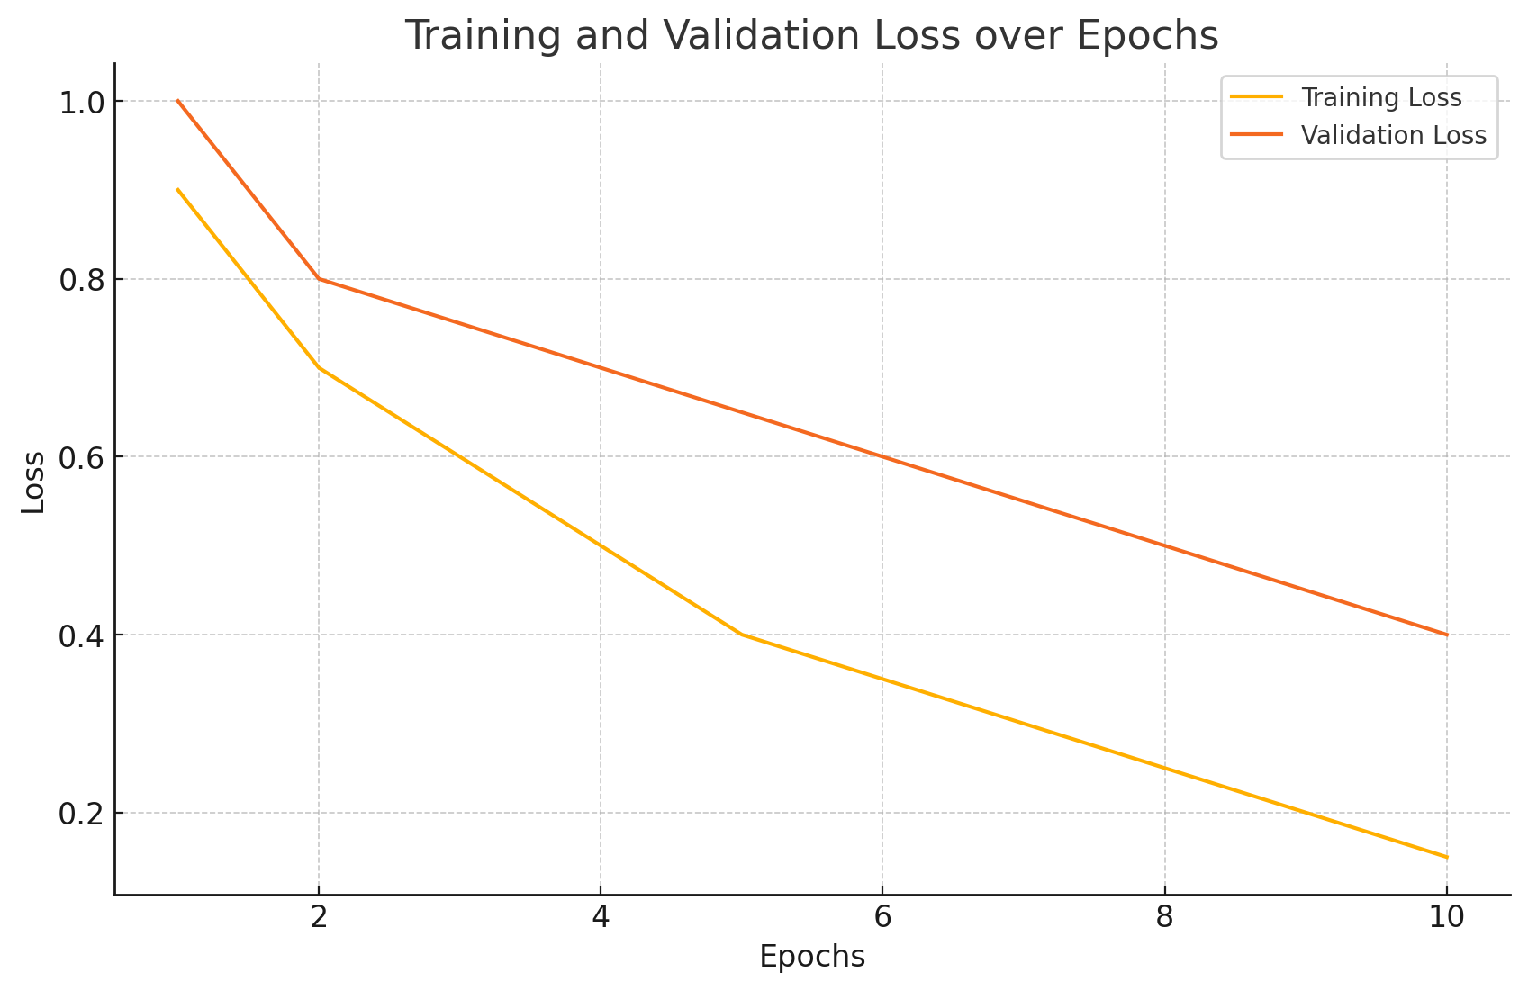
Results
Training loss: This is the error on the training data, showing how well the model is fitting the training set.
Validation loss: This is the error on a separate validation dataset, used to evaluate how well the model generalizes to unseen data.
For each test image, you will get a printed prediction like this:
The first image (e4e343eaae2a.png) is predicted to belong to class 3.
The second image (e4f12411fd85.png) is predicted to belong to class 1.
The actual output will depend on the predictions made by model. Each class label (0 to 4) corresponds to one of the 5 output classes you've set up in your model, and the predicted class index will be printed

Slide 9
Future work
Data Augmentation: Apply techniques like rotation, flipping, and zooming to increase dataset diversity and improve generalization.
Model Optimization: Fine-tune hyperparameters, experiment with different optimizers, and consider model pruning to improve performance and efficiency.
Advanced Architectures: Experiment with deeper ResNet variants or models like EfficientNet or Vision Transformers for better accuracy.
Ensemble Methods: Combine multiple models to improve prediction accuracy and reduce overfitting.
Integration with Clinical Data: Combine retinal images with other medical data (e.g., blood sugar levels) to enhance prediction accuracy.
Deployment: Optimize the model for real-time usage on mobile or edge devices and develop a user-friendly interface for medical professionals.
Monitoring Disease Progression: Implement a system to track the progression of diabetic retinopathy over time in patients.

